Slide 1
Getting started with
Android Programming
Mr. Yous Sopheap

Slide 2
Course Overview
What is Android?
Android Version
Features of Android
Architecture of Android
Android Device in the Market
The Android Market
The Android Developer Community
Mr. Yous Sopheap

Slide 3
What is Android?
□ Android is a software stack for mobile devices that includes an operating system, middleware and key applications.
Mr. Yous Sopheap

Slide 4
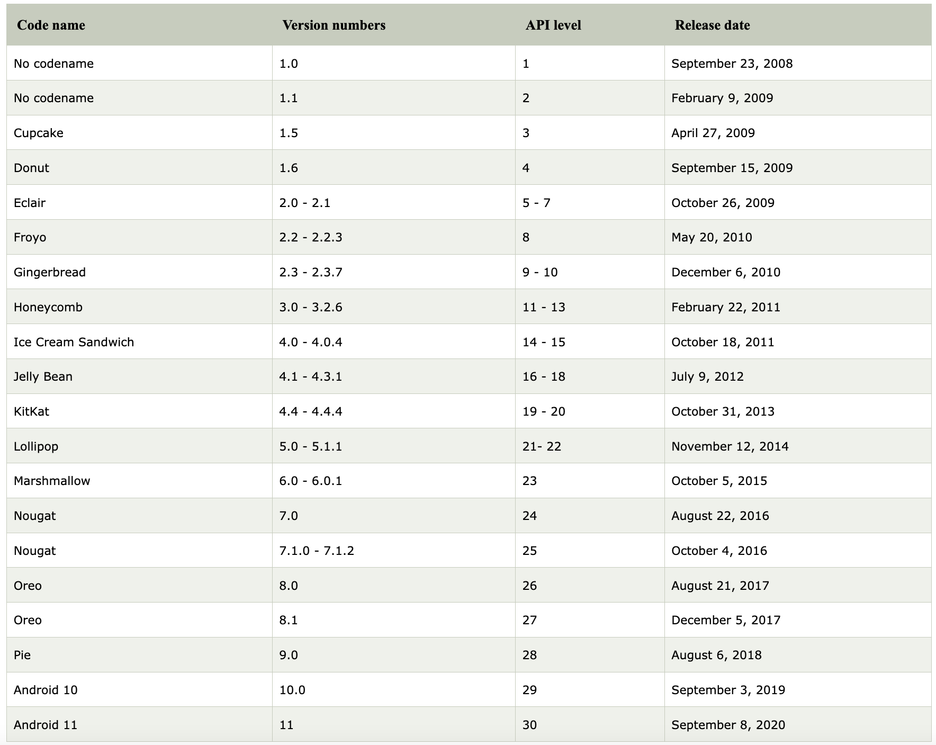
Android Version
Mr. Yous Sopheap

Slide 5
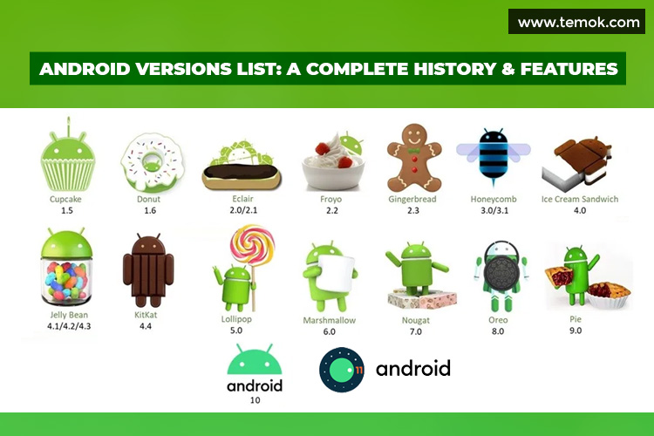
Android Version
Mr. Yous Sopheap

Slide 6
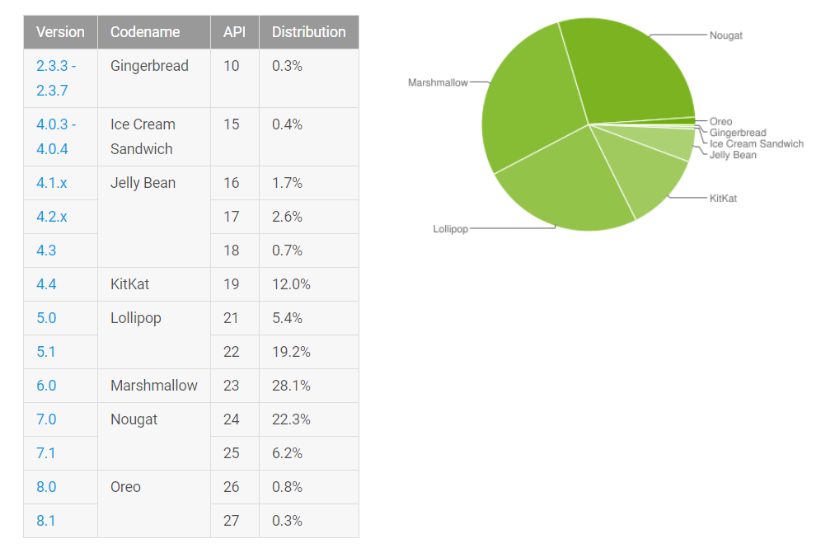
Current Distribution
Mr. Yous Sopheap

Slide 7
Android Features
Storage
Connectivity
Message
Web Browser
Media Support
Mr. Yous Sopheap

Slide 8
Features for Developer
Android ផ្តល់អោយ developers
ដើម្បីអភិវឌ្ឍតែមួយគត់
ច្នៃប្រឌិត​ applications
ទទួលបាន applications​ នៅក្នុងដៃរបស់អតិថិជន។
Mr. Yous Sopheap

Slide 9
Android Architecture
Mr. Yous Sopheap

Slide 10
Android - Applications
Android provides a set of core applications:
Email Client
SMS Program
Calendar
Maps
Browser
Contacts
Etc
All applications are written using the Java language.
Mr. Yous Sopheap

Slide 11
Android – App Framework
Enabling and simplifying the reuse of components
Developers have full access to the same framework APIs used by the core applications.
Users are allowed to replace components.
Mr. Yous Sopheap

Slide 12
Android – App Framework (cont)
□ Features
Feature | Role
View System | Used to build an application, including lists, grids, text boxes, buttons, and embedded web browser
Content Provider | Enabling applications to access data from other applications or to share their own data
Resource Manager | Providing access to non-code resources (localized strings, graphics, and layout files)
Notification Manager | Enabling all applications to display customer alerts in the status bar
Activity Manager | Managing the lifecycle of applications and providing a common navigation backstack
Mr. Yous Sopheap

Slide 13
Android - Libraries
Including a set of C/C++ libraries used by components of the Android system
Exposed to developers through the Android application framework
Mr. Yous Sopheap

Slide 14
Android - Runtimes
Core Libraries
Providing most of the functionality available in the core libraries of the Java language
APIs
Data Structures
Utilities
File Access
Network Access
Graphics
Etc
Mr. Yous Sopheap

Slide 15
Android – Runtimes (cont)
Dalvik Virtual Machine
Providing environment on which every Android application runs
Each Android application runs in its own process, with its own instance of the Dalvik VM.
Dalvik has been written such that a device can run multiple VMs efficiently.
Register-based virtual machine
Mr. Yous Sopheap

Slide 16
Android – Runtimes (cont)
Dalvik Virtual Machine (Cont)
Executing the Dalvik Executable (.dex) format
.dex format is optimized for minimal memory footprint.
Compilation
Relying on the Linux Kernel for:
Threading
Low-level memory management
Mr. Yous Sopheap

Slide 17
Android - Kernel
Relying on Linux Kernel for core system services
Memory and Process Management
Network Stack
Driver Model
Security
Providing an abstraction layer between the H/W and the rest of the S/W stack
Mr. Yous Sopheap

Slide 18
Android Devices in the Market
Smart Phone
Tablets
E-reader
Netbooks
Mp4 Player
Internet TV
http://www.android.com/devices/
Mr. Yous Sopheap

Slide 19
Phones
HTC G1,
Droid,
Tattoo
Nexus 4
Motorola Droid (X)
LG Optimus G
Samsung Galaxy
Sony Ericsson
Mr. Yous Sopheap

Slide 20
Tablets
Velocity Micro Cruz
Gome FlyTouch
Acer beTouch
Toshiba Android SmartBook
Cisco Android Tablet
Dawa D7
Mr. Yous Sopheap

Slide 21
Android Market
In August 2008, Google announced Android Market and made it available in Oct 2008.
Preinstall in every android devices.
To download third-party application
Mr. Yous Sopheap

Slide 22
Development
JDK
IDE – Eclipse
Eclipse plug-in - ADT
Software Development Kit (SDK)
Android Emulator
Debuger
Mr. Yous Sopheap

Slide 23
Thank you!
Mr. Yous Sopheap

