Slide 1
Web Programming
Teach by : YOUS SOPHEA
Phone Numbers and Telegrams
(093 58 22 57 / 068 58 22 55)

Slide 2
គោលបំណង
ចេះប្រើ HTML tags
ចេះប្រើ CSS ជាមួយ HTML
ចេះបង្កើត Web pages

Slide 3
I. Introduction to the Internet and HTML

Slide 4
1. What’s Internet?
Is the collection of computers around the world that are all connected to each other.
Is a world wide collection of computer network, cooperating with each other to exchange data using a common software standard.

Slide 5
2. What make up the Internet?
Server: is the server computers that run continuously and always connect to the Internet and waiting for requests from clients at all the time.
Client: is the computer that request resources from the server.
Router: is a device that connects to networks that forwards packet from one network to another.
Connection: is describing how you can connect from one point to another.

Slide 6
3. What’s HTML?
HTML stands for Hypertext Mark-up Language.
An HTML file is text file containing small markup tag.
The Markup tags tell the browser how to display the pages.

Slide 7
II. HTML Basic

Slide 8
1. How to create HTML files?
We can use a text editor like notepad, WordPad
We can use web pages editor like FrontPages, Dream Waver
The files must be saved with extension *.html or *.htm

Slide 9
Ex: firstpage.html
<html>
<head>
<title>The title of page</title>
</head>
<body>
<b>Hello world</b>
html element and contents.
</body>
</html>
យួស សុភា 093 58 22 57

Slide 10
HTML Structure:
<html>
<head>
<title></title>
</head>
<body>
Element content
</body>
</html>
យួស សុភា 093 58 22 57

Slide 11
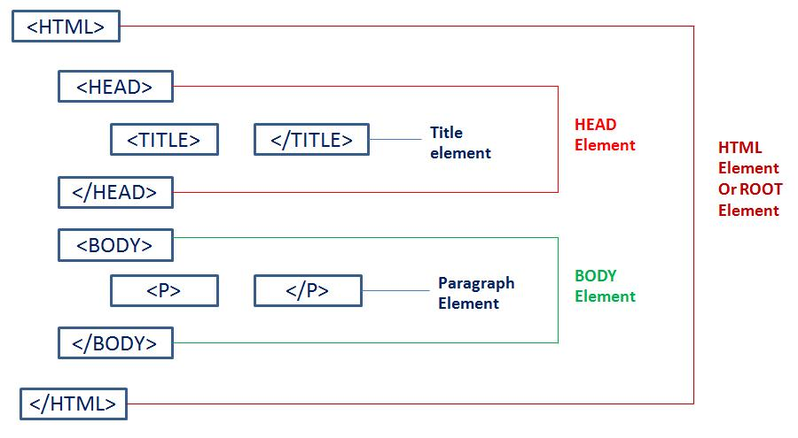
2. HTML Element
យួស សុភា 093 58 22 57

Slide 12
Attributes
All HTML elements can have attributes
Attributes provide additional information about an element
Attributes are always specified in the start tag
Ex.
<img src="img_girl.jpg">
- img is a tag
- src is an attritute
យួស សុភា 093 58 22 57

Slide 13
3. Basic HTML Tags
Headings
<html>
<body>
<h1>Heading 1</h1>
<h2>Heading 2</h2>
<h3>Heading 3</h3>
<h4>Heading 4</h4>
<h5>Heading 5</h5>
<h6>Heading 6</h6>
</body>
</html>
Please check your result on your own pc
យួស សុភា 093 58 22 57

Slide 14
Paragraph
<html>
<body>
<p align="left">This is a paragraph.</p>
<p align="center">This is a paragraph. .</p>
<p align="right">This is a paragraph. .</p>
</body>
</html>
Please check your result on your own pc
យួស សុភា 093 58 22 57

Slide 15
HTML Formatting text
<b> - Bold text
<strong> - Important text
<i> - Italic text
<em> - Emphasized text
<mark> - Marked text
<small> - Small text
យួស សុភា 093 58 22 57

Slide 16
HTML Formatting text
<big> - Big text
<del> - Deleted text
<ins> - Inserted text
<u>- Underline text
<sub> - Subscript text
<sup> - Superscript text
យួស សុភា 093 58 22 57

Slide 17
HTML Style
Use background-color for background color
Use color for text colors
Use font-family for text fonts
Use font-size for text sizes
Use text-align for text alignment
យួស សុភា 093 58 22 57

Slide 18
Font
Font face <font face=“font name”>
Font size <font size=“number”>
Font color <font color=“color name”>
Ex
<font face="verdana" color="green“ size=“6”>This is some text!</font>
យួស សុភា 093 58 22 57

Slide 19
Font size
Ex
<p><font size="1">Font size 1</font>
<p><font size="2">Font size 2</font>
<p><font size="3">Font size 3</font>
<p><font size="4">Font size 4</font>
<p><font size="5">Font size 5</font>
<p><font size="6">Font size 6</font>
<p><font size="7">Font size 7</font></p>
Font size | 1 | 2 | 3 | 4 | 5 | 6 | 7
Pixel size | 10,11,12 | 13,14,15 | 16,17 | 18,20 | 24,28 | 32,40 | 48
យួស សុភា 093 58 22 57

Slide 20
Block quote
<blockquote> Display a long quotation
<blockquote> Display a long quotation Display a long quotation Display a long quotation Display a long quotation Display a long quotation Display a long quotation Display a long quotation</blockquote>
(Practice this)
Please check this result in your own computer
យួស សុភា 093 58 22 57

Slide 21
Preformatted text
<pre> Display text that you want to show and it is not change your form in your code
Ex <pre> Display text Display text Display text
Display text Display text </pre>
Please check your result
យួស សុភា 093 58 22 57

Slide 22
Adding horizontal line
Ex
<h3 align="center">Adding horizontal line</h3>
<hr width="100" align="center">
<hr width="200" align="center" color="blue">
<hr width="400" align="center" color="red">
<hr width="600" align="center" color="green">
យួស សុភា 093 58 22 57

Slide 23
Animation with marquee
+ Marquee attribute:
bgcolor=”color”: This sets the background color for marquee path
width=”n”: how wide the marquee is
height=”n”: how tall the marquee is
direction=”left | right | top | down”: which direction the marquee should scroll
យួស សុភា 093 58 22 57

Slide 24
Animation with marquee
+ Marquee attribute:
behavior=”scroll or slide or alternate”: what type of scrolling
scrolldelay=”n”: how long to delay between each jump
scrollamount=”n”: how far to jump
loop=”n”: how many times to loop
hspace=”n”: horizontal space around the marquee
vspace=”n”: vertical space around the marquee
យួស សុភា 093 58 22 57

Slide 25
Layout with Body
+ Body attributes:
bgcolor: background color of the page
background: background picture for the page
text: color of the text on the page
topmargin: size of top and bottom margins
leftmargin: size of left and right margins
marginheight: size of top and bottom margins
marginwidth: size of left and right margins
យួស សុភា 093 58 22 57

Slide 26
Special characters
Characters Number | Name | Symbol
34 | quot | “
38 | amp | &
60 | lt | <
62 | gt | >
160 | nbsp | space
161 | iexcl | ¡
162 | cent | ¢
163 | pound | £
165 | yen | ¥
169 | copy | ©
174 | reg | ®
យួស សុភា 093 58 22 57

Slide 27
<p>This is &#34;</p>
<p>This is &#38;</p>
<p>This is &#60;</p>
<p>This is &#62;</p>
<p>This is &#160;</p>
<p>This is &cent;</p>
<p>This is &pound;</p>
<p>This is &yen;</p>
<p>This is &copy;</p>
<p>This is &reg;</p>
យួស សុភា 093 58 22 57

Slide 28
Thanks you !!!
យួស សុភា 093 58 22 57

